Slide 1



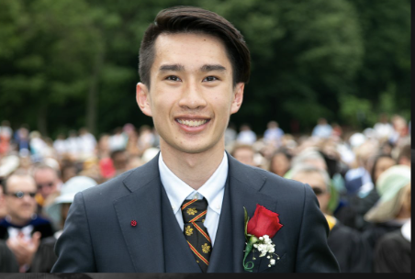

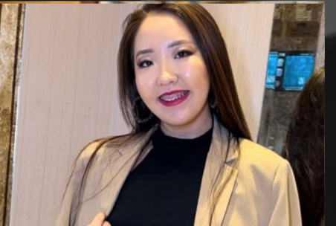
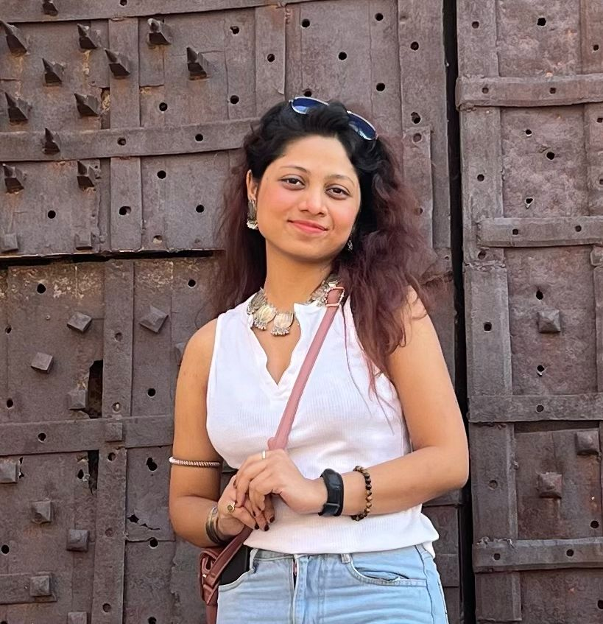
GreenWheel RideE Marketing Strategy Project
Shreya Shreya Project Coordinator
Ky Anh Nguyen
Financial Analyst
Xinwei Huang (Kaitlyn)
Market Research Analyst
Madina Abbassova
Marketing and Communication lead
Sejal Khadkikar
Project Development Specialist

Slide 2
Table of contents
01
02
03
04
05
Project & Strategy
Planning
Scope Management, Stakeholder Interest, Time Management, Communication Plan and Network, Estimated budget, Change Management
Introduction, Project Process, Initiation
Execution
Marketing Campaign
Monitoring & Control
Closure
Wrap up, deep dive stakeholder focus, continued success insights
Key areas of Monitor and Control

Slide 3

01
Project & Strategy

Slide 4
Introduction
Industry: Electric Vehicle (EV) Market
Market size: $500 billion in manufacturing investment over next decade (Pwc)
About 64% of passenger cars sold in 2030 will be a battery electric vehicles (S&P)
Main Competitors:
Zero Motorcycles, Harley-Davidson, Niu Technologies, Tesla, Inc.
About GreenWheel RideE
Founded in 2020, NY, USA
New Class of Motorbikes
The latest breakthrough in urban mobility
https://www.pwc.com/us/en/industries/industrial-products/library/automotive-industry-trends.html
https://www.spglobal.com/mobility/en/topic/electric-vehicle-trends.html
Notes:
Cross check Numbers + annual growth rate

Slide 5
GreenWheel RideE Project
Mission
Vision
Objectives
Key Initiatives
Revolutionize urban mobility by offering an eco-friendly electric motorbike that enhances commutes, reduces environmental impact, and supports a sustainable future.
Pioneering the transformation of urban mobility with innovative and accessible electric motorbikes for a sustainable future.
Develop and market high-performance, eco-friendly electric motorbikes to establish market leadership and promote sustainable urban commuting.
Integrate advanced technology, expand market reach, enhance customer engagement, and uphold stringent compliance standards to drive growth and sustainability.
Notes:
Text + project name

Slide 6
Project Process
1
2
3
Setting Up Manufacturing Process
Quality Control Analysis
Developing Marketing Strategy
6
5
4
Monitoring & Optimize Project
Establishing Distributor Network & Customer Services
Organizing a Launch Event

Slide 7
Initiation
Project Period: 24 weeks
Budget:$985,000
Scope
Design and development of the GreenWheel RideE
Creation and execution of a marketing strategy
Establishment of a manufacturing workflow
Setup of a distribution network.
Milestone
Completion of design and prototype approval
Finalization of manufacturing processes and production
Launch of the GreenWheel RideE marketing campaign
Official market release of the GreenWheel RideE
Deliverable
Design and development of the GreenWheel RideE
Creation and execution of a marketing strategy
Establishment of a manufacturing workflow
Setup of a distribution network.
Stakeholders
GreenWheel Executive Team
Project Manager
Design and Development Teams
Marketing and Sales Teams
Distribution Partners
Regulatory Bodies
Notes:
Remove unused boxes/ add major details from each on screen

Slide 8
Initiation
Project Period: 24 weeks
Budget:$985,000
Approval Requirements
GreenWheel Executive Team
Regulatory Compliance Bodies
Financial Stakeholders
…
Assumption
Market demand for electric motorbikes will continue to rise.
Regulatory approval for new electric vehicles will be obtained without significant delay.
The project will remain within the allocated budget and timeline constraints.
Constrains
Fixed budget and resource allocation.
Market entry timing must coincide with peaks in consumer demand.
Compliance with international electric vehicle standards
Notes:
Remove unused boxes/ add major details from each on screen

Slide 9
02
Planning

Slide 10

High Level Project Scope
Launch an electric motorbike line, the GreenWheel RideE that meets sales target of 12,000 unit for 1st year, (1% of last year’s overall USA electric vehicle sales)
Create and execute marketing strategies
Conduct market research and craft branding campaigns.
Focus on market penetration and consumer engagement.
Align with sustainability goals and enhance GreenWheel 's market position.

Slide 11
Scope Management Challenges and Recommendations
Adjusting to market changes
Balancing stakeholder expectation and project goals
Allocating Resource effectively
Develop flexible strategy and stay agile with responsive plan
Transparent Communication plan
Leverage project management tool
Maintaining team Collaboration
Foster communication with frequent team check-ins and updates.

Slide 12
Responsibility Matrix
Tasks/ Roles | Shreya (Project Coordinator) | Ky Anh (Financial Analyst) | Kaitlyn (Market Research Analyst) | Sejal (Product Development Specialist) | Madina (Marketing and Communication Lead)
Project Plan Development | P | S | S | S | S
Task delegation & Scheduling | P | S | S | S | S
Progress Tracking | P | S | S | S | S
Stakeholder Communications | P |  |  |  | S
Cost Analysis | S | P | S
Budgeting | S | P
Financial Forecasting |  | P | S
Market demand Analysis |  |  | P | S | S
Competitor Analysis |  |  | P | S | S
P : Primary S : Secondary

Slide 13
Responsibility Matrix
Tasks/ Roles | Shreya (Project Coordinator) | Ky Anh (Financial Analyst) | Kaitlyn (Market Research Analyst) | Sejal (Product Development Specialist) | Madina (Marketing and Communication Lead)
Pricing Strategy |  | S | P | S | S
Design and Feature Development |  |  |  | P | S
Sustainability Integration |  |  |  | P | S
Marketing Plan development | S |  |  |  | P
Launch Event Planning | S |  |  |  | P
Market Penetration Strategy | S |  |  |  | P
Communication Strategy | P | S | S | S | P
P : Primary S : Secondary

Slide 14
StakeHolder Interest Grid
Keep Satisfied
Manage Closely
Regulatory bodies
Suppliers and Vendors
GreenWheels Senior management team
Project team
Investors and Shareholders
Sales team
Marketing Agencies/ Consultants
Low Power High
Monitor
Keep Informed
Dealers and Retailers
Marketing and advertising partners
Non-target market consumers
General public
Customers
Environmental Groups
Community leaders
Local Community
Customer service team
Low Interest High

Slide 15
Time Management
Activity | Description | Duration (in weeks) | Predecessors | EST | EFT | LST | LFT | Total Float | Free Float
A | Market Research | 4 | - | 0 | 4 | 0 | 4 | 0 | 0
B | Product Positioning | 4 | A | 4 | 8 | 4 | 8 | 0 | 0
C | Marketing Strategy Development | 3 | B | 8 | 11 | 9 | 12 | 1 | 1
D | Creative Development | 4 | B | 8 | 12 | 8 | 12 | 0 | 0
E | Campaign Setup | 3 | C,D | 12 | 15 | 12 | 15 | 0 | 0
F | Launch Marketing Campaign | 6 | E | 15 | 21 | 15 | 21 | 0 | 0
G | Evaluation | 3 | F | 21 | 24 | 21 | 24 | 0 | 0
Critical path : A→ B → D → E → F→ G
Total length : 5.5 months (24 weeks)

Slide 16
Strategic planning project plan
Steps | 0-4 | 5 | 6 | 7 | 8 | 9 | 10 | 11 | 12 | 13 | 14 | 15 | 16 | 17 | 18 | 19 | 20 | 21 | 22 | 23 | 24
A. Market Research
B. Product Positioning
C. Marketing Strategy development
D. Creative Development
E. Campaign Setup
F. Launch Campaign
G. Evaluation

Slide 17
Communication Plan : Tools
Tool
Description
Trello | Manages tasks, sets deadlines, assigns responsibilities, and tracks progress.
Microsoft Project | Creates Gantt charts, schedules projects, allocates resources, and monitors tasks.
Smartsheet | Combines spreadsheets and project management tools for collaboration and progress tracking.
Google Analytics | Analyze market trends, competitors, and SEO insights.
SurveyMonkey & Typeform | Gather consumer feedback and preferences via surveys.
QuickBooks | Helps manage project budgets, expenditures, and financial reporting.
Microsoft Excel | Versatile for budget tracking, financial forecasting, and scenario analysis.
1. Project Management
2. Market Research
3. Financial Management

Slide 18
Communication Plan : Tools
Tool
Descriptions
4. Marketing Strategy and Execution
Salesforce | For Customer Relationship Management (CRM), automate marketing, and integrate customer data.
Hootsuite/Buffer | Schedule and monitor social media posts, analyze traffic.
Adobe Creative Suite | Use for creating brochures, banners, and online marketing materials.
Canva | A user-friendly option for teams to create visual content quickly.
Slack | For internal team communication and integration with other project management tools.
Zoom | For video conferencing, team meetings, and real-time communication.
5. Design and Creative tools
6. Collaboration - Communication

Slide 19
Communication Plan : Tools
Tool
Descriptions
Google AdWords and Facebook Ad Manager: | For managing online ad campaigns and monitoring their performance.
Tableau | For creating dashboards and visualizing marketing data to analyze campaign effectiveness.
Google Drive | Cloud storage solutions for sharing and storing project documents, creatives, and other files securely.
Risk register in excel | To document and track potential risks, their impact, and mitigation strategies.
MindTools | For deeper analysis and tracking of project risks.
7. Monitoring & Analytics
8.Documentation & Storage
9. Risk Management

Slide 20
Communication Plan : Techniques
Market Research: Use surveys and market segmentation for consumer insights and competitor analysis.
Digital Marketing: Implement SEO, PPC, and social media advertising to expand reach.
Event Marketing: Organize launch events and trade shows to engage directly with potential customers.
Content Marketing: Create engaging blogs, videos, and newsletters to build brand loyalty.
Public Relations: Manage media relations and press releases to enhance brand image.
Sales Promotions: Implement discounts and incentives to boost sales.
Partnerships: Collaborate with influencers and industry leaders to reach new audiences.

Slide 21
Communication Network
Team Coordination
Vendor Communication
Connects team members for daily operations and task alignment.
Coordinates with vendors and agencies for timely delivery of materials and services.
T
V
Stakeholder Engagement
Emergency Communication
S
E
For high-level interactions with sponsors and senior management focused on strategic impacts.
Rapid response protocols for urgent issues affecting project timelines.
Customer Feedback
Marketing Communication
C
M
For gathering customer insights to refine marketing and product strategies.
Utilizes digital and traditional media for public communications and promotions.

Slide 22
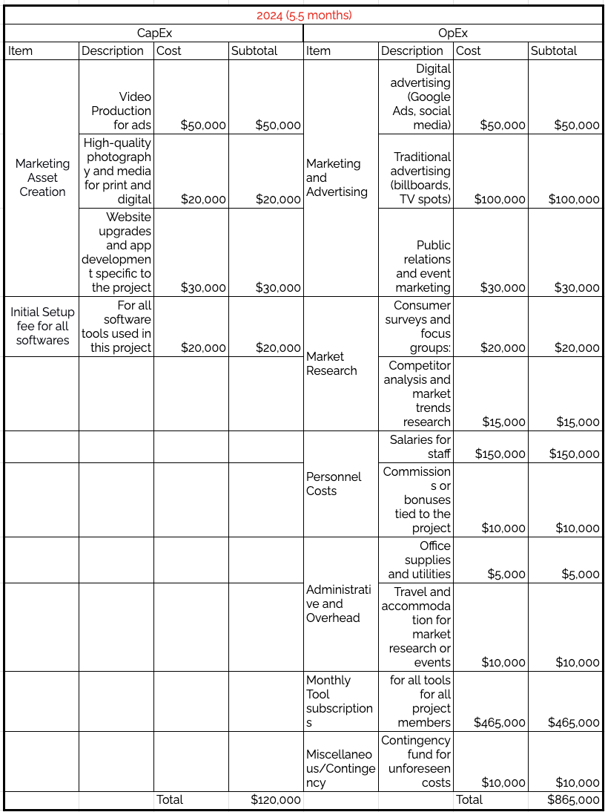
Estimated Cost
Total Cost for 5.5 months = $985,000

Slide 23
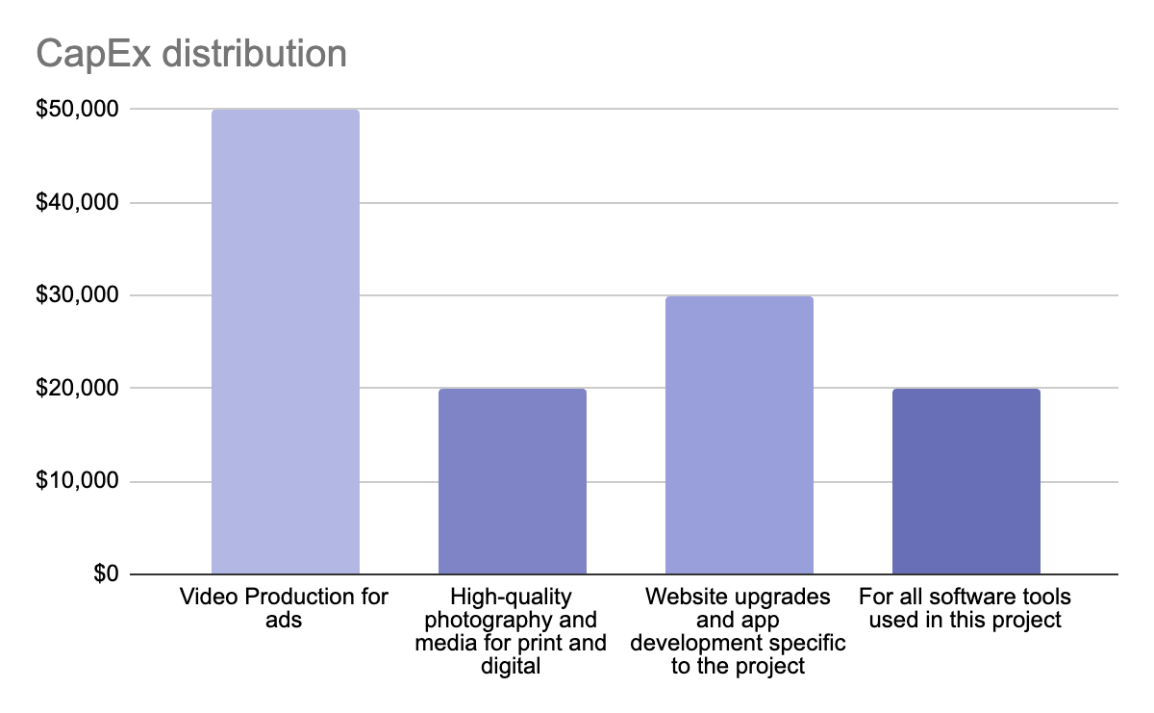
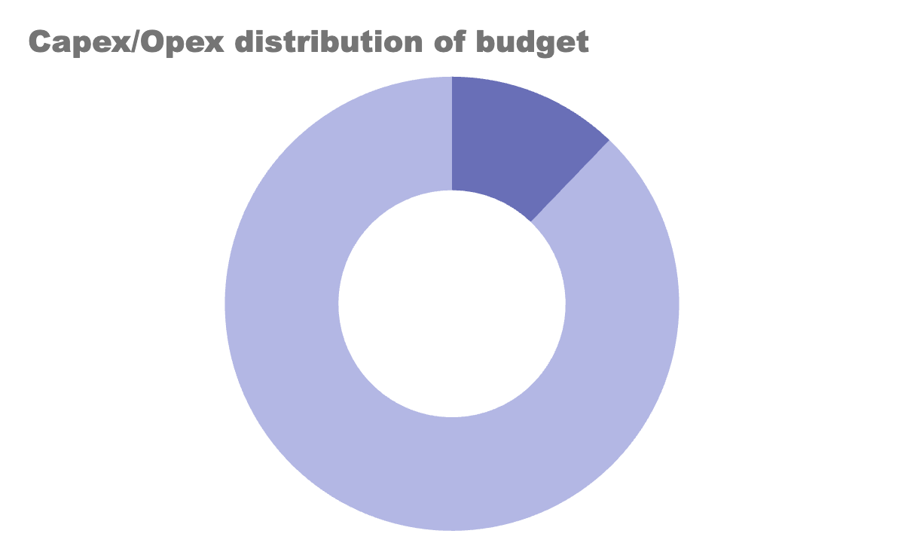
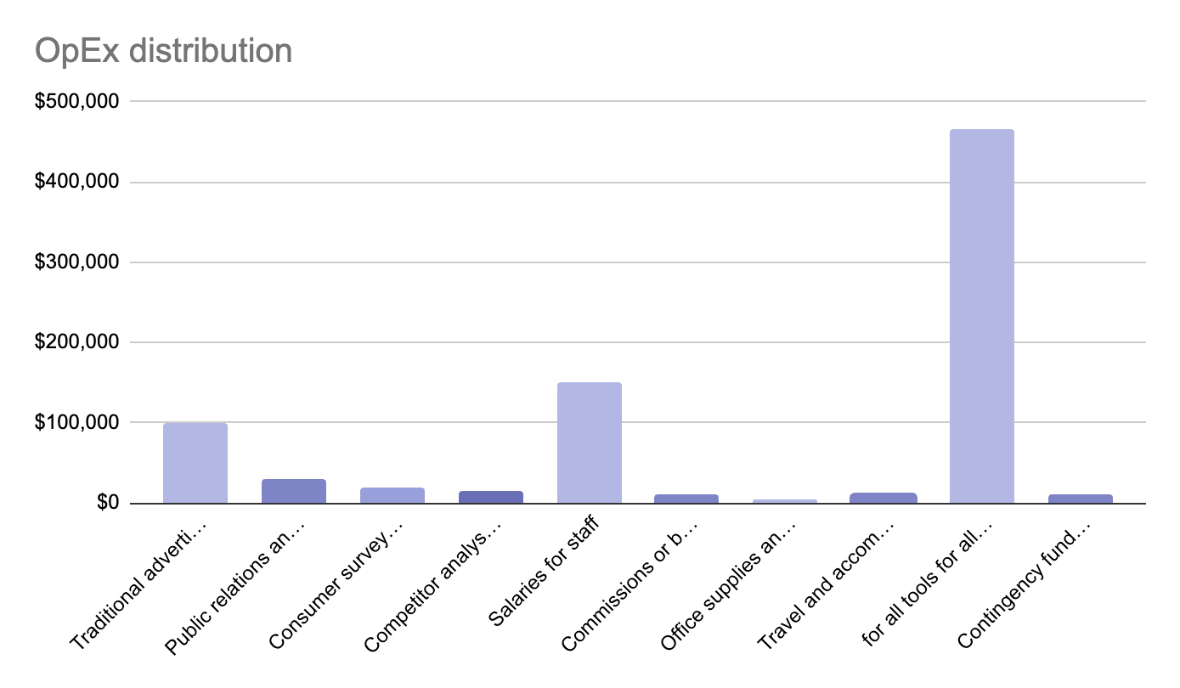
Project Budget
12.2% CapEx
87.8% OpEx

Slide 24
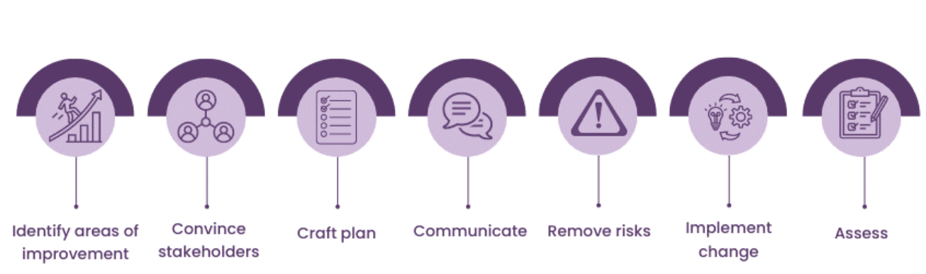
Change management Need & plan
Scope Creep Prevention: Maintain focus on original project boundaries to prevent scope expansion.
Formal Change Control: Utilize a structured approach to assess and approve changes based on their impacts.
Continuous Monitoring and Updates: Keep all stakeholders informed through regular communication and updated documentation.
Adaptation Support: Provide necessary training for new tools or processes resulting from changes.
Revised Metrics: Update performance metrics to reflect changes and measure project success accurately.

Slide 25
03
Execution

Slide 26
Marketing campaign
Billboards
Objective: Maximize exposure of the GreenWheel RideE to urban commuters and environmental enthusiasts by placing billboards in strategic locations that ensure high traffic visibility.
Strategy:
Location Selection
Design
Message
Digital Integration
Execution:
Agent coordination
Collaboration w/ design teams
Schedule
Evaluation:
Track the success
Conduct surveys

Slide 27
Marketing Campaign
Category | Details
Leadership and Coordination | Project Manager: Oversees all execution activities, ensuring alignment with project goals. Team Collaboration: Regular meetings to maintain alignment and address issues.
Resource Management | Budget Oversight: Monitoring and managing expenditures to stay within budget limits. Vendor Management: Ensuring suppliers and partners meet their obligations and timelines.
Marketing Rollout | Digital Campaign Launch: Initiate with teaser content, followed by full-scale digital marketing ($50,000). Traditional Advertising: Employ billboards and TV spots to enhance visibility ($100,000). Event Coordination: Manage logistics and content for the launch event, and coordinate public relations efforts to maximize impact ($30,000).
Leadership and Coordination | Project Manager : Oversees all executive activities, ensuring alignment with project goals. Team Collaboration : Regular meeting to maintain alignment and address issues.

Slide 28
Marketing Campaign
Category | Details
Market Research | Consumer Insights: Conduct surveys and focus groups to gather data on consumer preferences and reactions ($20,000). Competitive Analysis: Research market trends and competitor strategies to refine marketing approach ($15,000).
Monitoring and Adjustments | Performance Tracking: Use analytics to monitor online campaigns and adjust strategies as needed. Feedback Incorporation: Collect and integrate feedback to refine marketing and product strategies.
Documentation and Reporting | Progress Reports: Regular updates for stakeholders on marketing activities. Documentation: Keep records of all marketing materials, results, and agreements.

Slide 29
04
Monitoring & Control

Slide 30
Four Key Areas of Monitor and Control
Performance
Risk
Customer
Stakeholders
Designed to gauge progress and success
Risk management is critical for minimizing disruptions
Customer feedback is vital for adapting to user needs
Stakeholder management is crucial for support

Slide 31
Performance and Quality Control
Metrics | A | B | C | D | Program
BAV
EV
AC
PV
CV
CPI
SPI
EAC
VAC
ETC
Sales Volume and Revenue: Monitor these metrics against forecasts to assess market response and financial outcomes.
Customer Satisfaction Scores: Collect and analyze customer feedback to evaluate satisfaction levels and identify improvement areas.
Production Efficiency: Review production rates and resource usage to ensure efficient operations.
Quality Control Compliance: Track defect rates and warranty claims to assess quality management effectiveness.

Slide 32
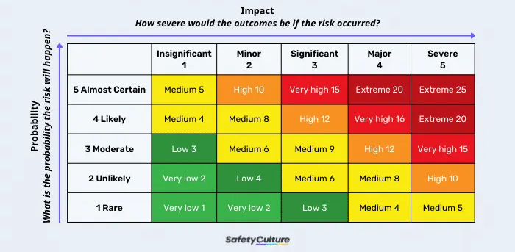
Risk Analysis and Mitigation
Risk Identification: Regularly identify potential risks associated with technology, supply chains, market conditions, and regulations.
Risk Assessment: Evaluate the likelihood and impact of identified risks to prioritize management resources.
Risk Mitigation Strategies: Develop and implement appropriate strategies for critical risks, such as supply chain diversification and regulatory compliance.
Regular Review and Adjustment: Conduct periodic reviews to update risk status and adapt mitigation strategies as necessary.

Slide 33
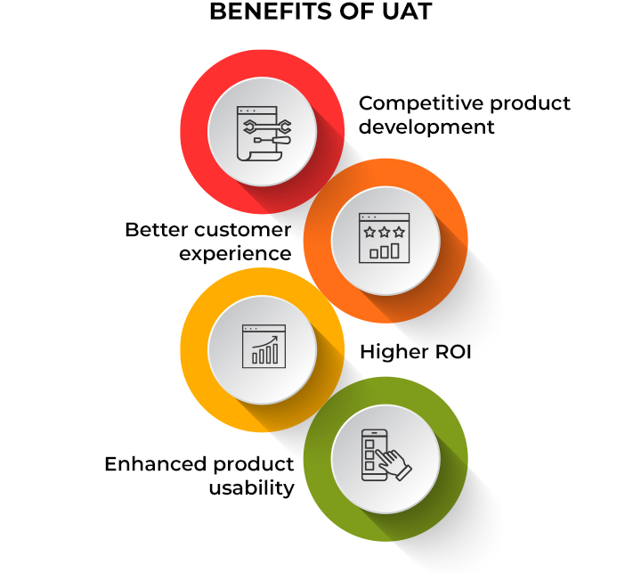
Customer Feedback
Real-Time Customer Feedback: Implement tools for gathering immediate feedback through digital platforms, ensuring quick responses to customer concerns and preferences.
Focus Groups and Surveys: Conduct regular surveys and focus groups to obtain in-depth insights into customer perceptions and expectations.
Competitive Analysis: Keep a close eye on competitors to maintain competitiveness and innovation in product offerings and marketing strategies.

Slide 34
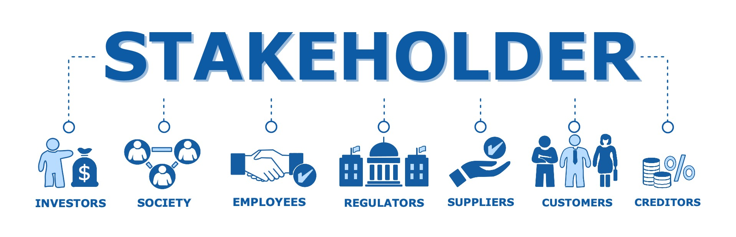
Stakeholder Management
In addition to Stakeholder Identification & Communication Plan:
Stakeholder Engagement: Regularly engage with stakeholders through meetings, updates, and participatory decision-making processes to ensure their ongoing support and input.
Feedback and Adaptation: Implement mechanisms to gather feedback from stakeholders and integrate it into project planning and execution. This will help in adapting strategies in line with stakeholder expectations and project goals.

Slide 35
05
Closure

Slide 36
GreenWheel RideE Marketing Campaign Wrap-Up
Key Activities for Project Closure :
Final Review Meeting | Documentation & Archiving
Financial Closure | Evaluation of Objectives
Discuss project goals, achievements, challenges, and gain sign-off from stakeholders.
Organize and store project documents for future reference.
Review budgets, reconcile expenses, and close out project accounts.
Assess how well we met project objectives and identify any deviations.

Slide 37


Deep Dive - Stakeholder focus
Stakeholder Satisfaction Assessment:
Conduct surveys/interviews to gather feedback on stakeholder experience.
Celebration & Recognition:
Organize a celebration to acknowledge team and stakeholder contributions.

Slide 38
Capturing Insights for continued success
Knowledge Transfer
Lessons Learnt
Continuous Improvement
Create a marketing playbook and training programs for GreenWheel RideE.
Reflect on project successes, highlighting effective outdoor advertising and digital marketing optimization.
Apply lessons learned to refine future marketing projects and strategies.

Slide 39
Thank You!

